Slide 1
Welcome to First Grade!
Mrs. Szram

Slide 2
Fast Facts
Miss Kuhn → Mrs. Szram
Class size- 12 kids
Room 105
Specials Schedule:
Monday Spanish
Tuesday Music
Gym
Wednesday Art
Library
Thursday Computer
Contact
Class website: https://misskuhnscb.weebly.com/
Email: kkuhn@scbspa.org
School Phone: (215) 639-3456
Remind App: See website for directions

Slide 3
Classroom Supplies
Copybooks
Sticker
Study Star
Homework Owl
Classwork Trolls
Fluency minion
Journal Smile
Theme Tablet
Folders
Color
Math Blue
ELA Purple
Test Green
Work Yellow/
Orange
Communication
Workbooks
Reader’s Notebook
Religion
Math
Art Box: crayons, glue stick, glue (liquid), scissors,
Pencils, erasers, red pencil, ruler
Total: $.19.75

Slide 4
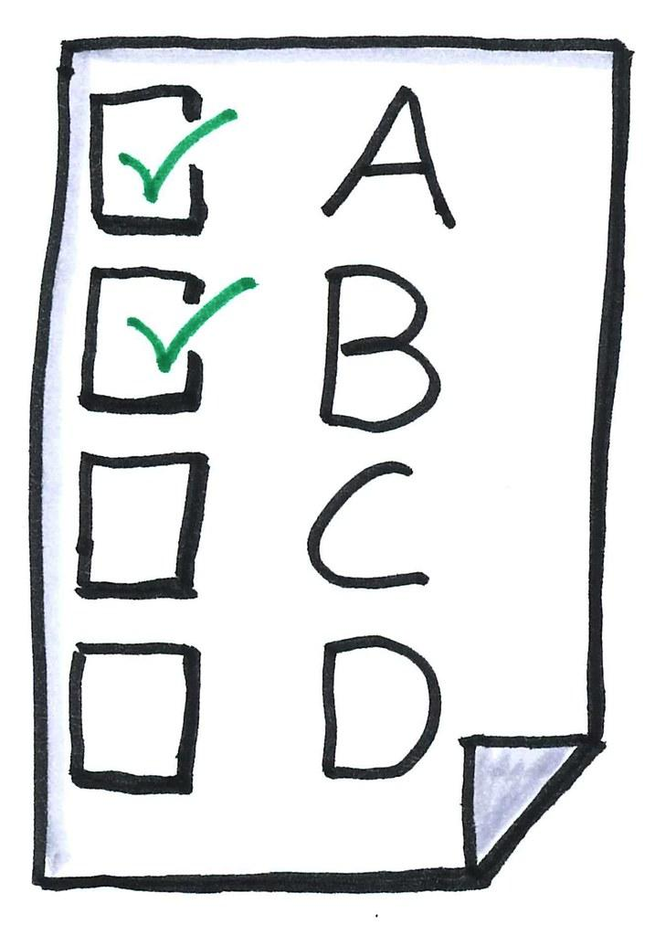
Grading
MSP-- Mandatory
Test Folders
Grading Breakdown
Reading
Math
Religion
Writing
Handwriting
Social Skills
Study Skills
Specials

Slide 5
Behavior Communication Folder
Chart
Green, Yellow, Red
Behavior Chart
In Communications Folder
Stickers
Sign daily
Check/Return daily
Sign chart
Notes
Label EVERYTHING
Homework/Important Info
HW on front
Important info on back
Change of transportation

Slide 6
Reading Series
Journey’s Series
Logging in
Vocabulary Words
In Star copy book
Highlighted words
Activities
Weekly Tests
Reading Counts (will address at the end)

Slide 7
Math
Progress in Mathematics
Workbook → packets
Activities/study
Quizzes/Tests
IXL

Slide 8
Religion Social Studies, Science
Christ Our Life
Prayers
Activities/Holy Days
Study/Tests
Activities
Grades/Tests (lack of)

Slide 9
Parade of Saints
Choosing Saint
Practicing
Costume
The show ????

Slide 10
Dress Code
https://misskuhnscb.weebly.com/
**Also found in the School Handbook
-- found on class website

Slide 11
Extra
Classroom Safety- masks, shields
Reading Counts
Conferences
Catapult Services
Birthdays/Holidays
No Pretzels
New lunch program starting in October
Questions/Concerns????

